Slide 1
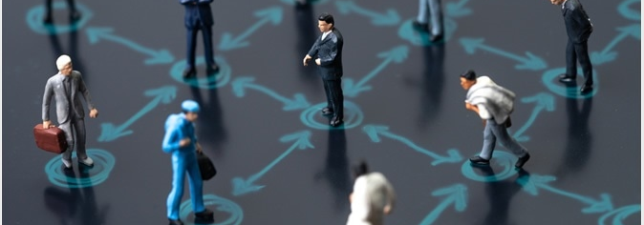
Social Distancing Alert System

Slide 2
Introduction
Overview :
COVID-19 spread is emotionally challenging for many people, changing day-to-day life in unprecedented ways. In the fight against this virus, social distancing has proven to be a very effective measure to slow down the spread of the disease.
This tool has following features:
Detect humans in the frame with yolov3.
Calculates the distance between every human who is detected in the frame.
Shows how many people are at High(red) and Low(green) risks
Purpose:
While millions of people are staying at home to help flatten the curve, many customers in the manufacturing and pharmaceutical industries are still having to go to work everyday to make sure our basic needs are met.To help ensure social distancing protocol in their workplace, I have developed an AI-enabled social distancing detection tool that can detect if people are keeping a safe distance from each other by analyzing real time video streams from the camera.

Slide 3
Requirements:
Numpy
Pandas
Opencv-python (CV2)
Imutils:
Argparse
Dlib
Tensorflow
Tensorflow GPU
Keras

Slide 4
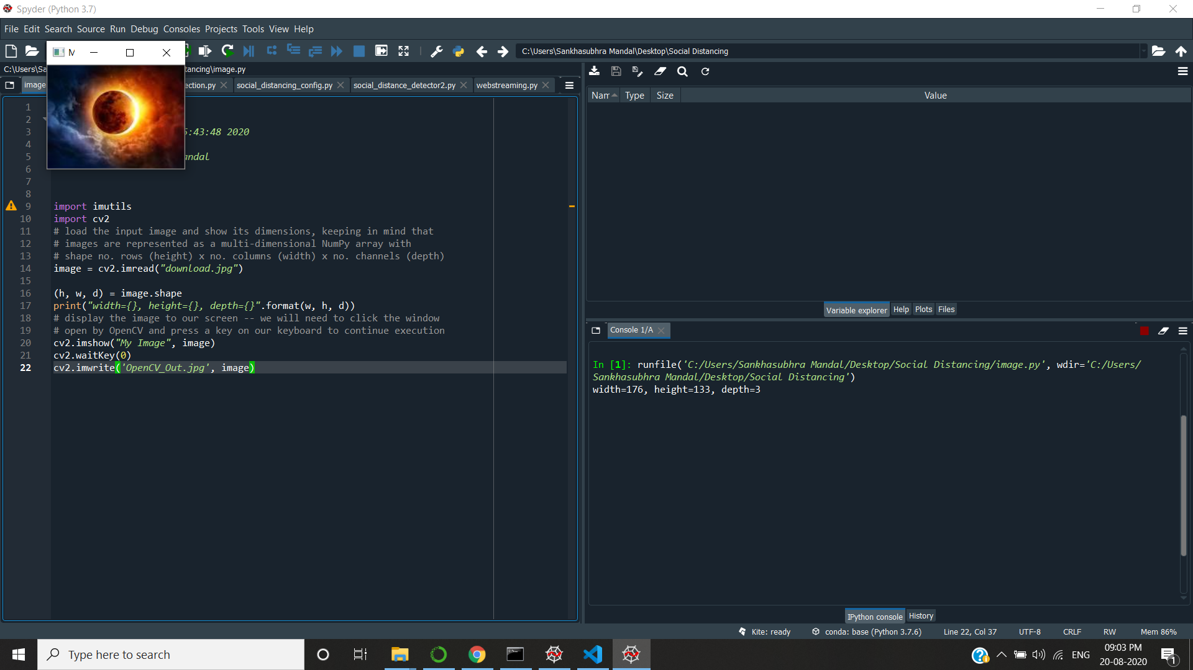
Results
Output:
width=176,
height=133,
depth=3
Running the image.py file to get the shape of download.jpg

Slide 5
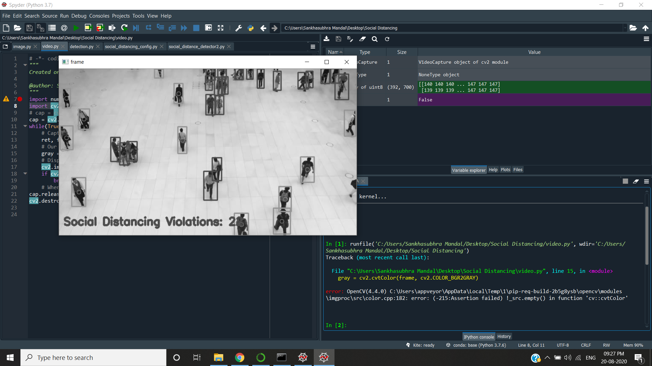
Running the video.py file getting this.

Slide 6
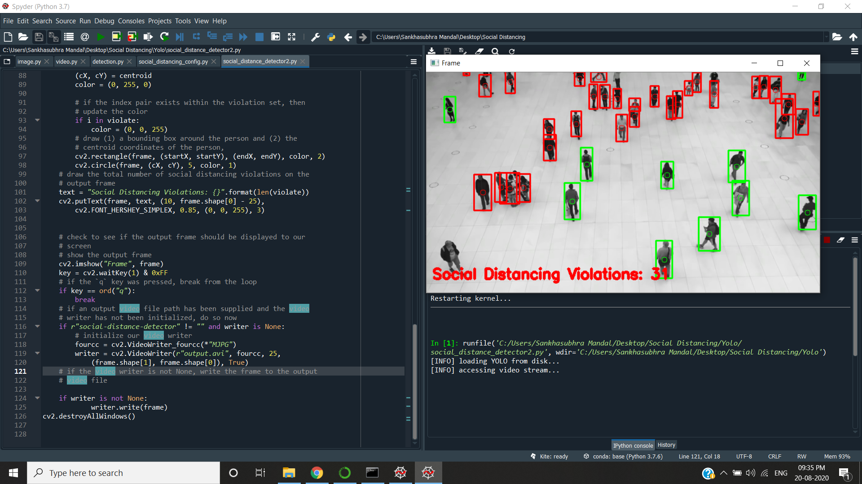
Running social_distance_detector2.py(taking inputs passes to arguments over detection.py and the path file also there social_distancing_config.py

Slide 7
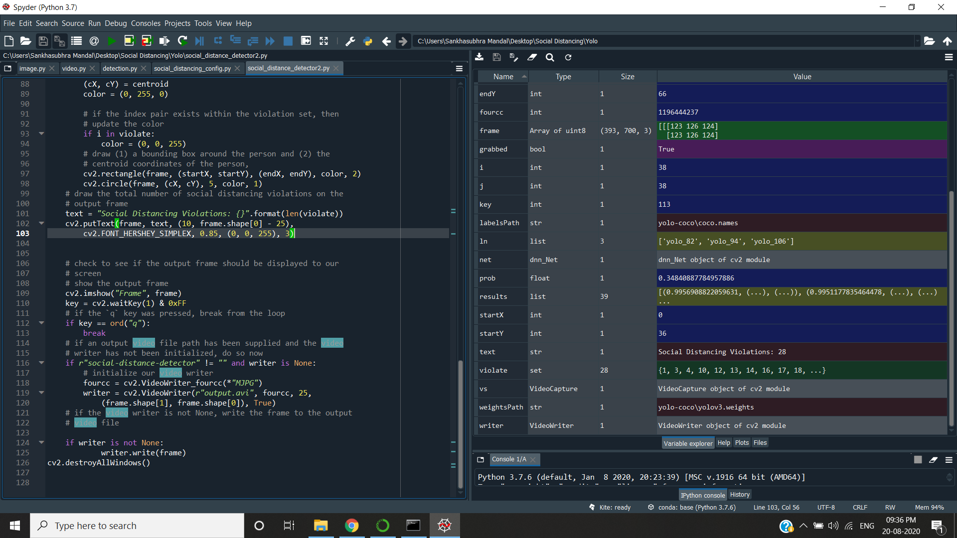
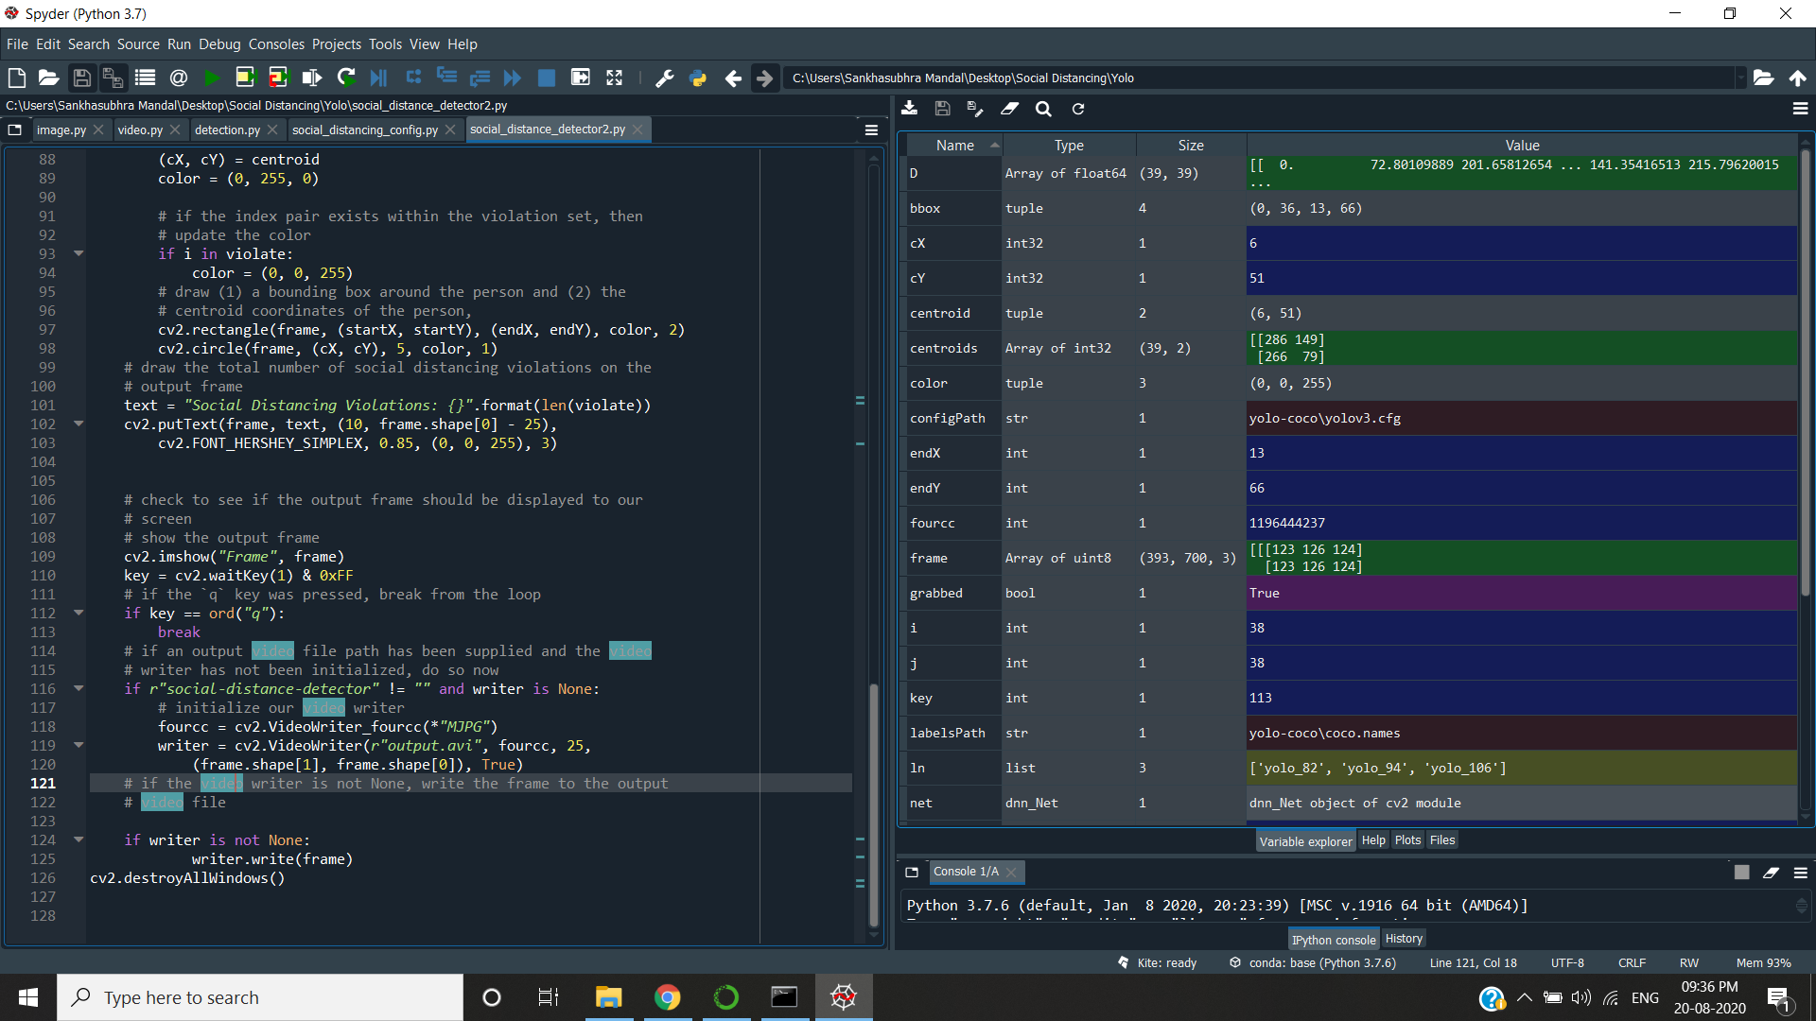

Slide 8
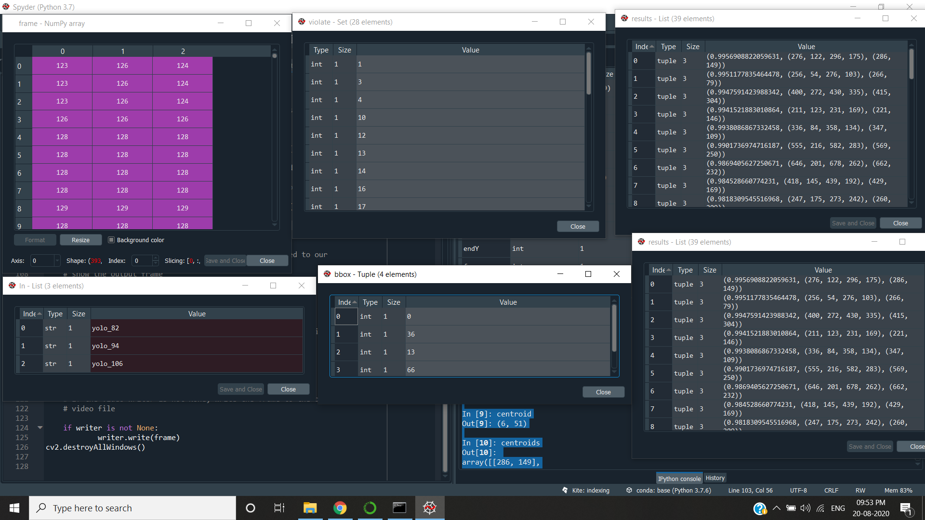

Slide 9
Output:
bbox: (0, 36, 13, 66)
cX: 6
cY: 51
centroid: (6, 51)
centroids:
array([[286, 149],
[266, 79],
[415, 304],
[221, 146],
[347, 109],
[569, 250],
[662, 232],
[429, 169],
[260, 209],
[ 98, 236],
[408, 51],
[479, 291],
[ 39, 65],
[371, 80],
[438, 50],
[564, 187],
[316, 42],
[674, 99],
[119, 18],
[297, 41],
[624, 38],
[157, 13],
[641, 102],
[345, 34],
[167, 204],
[147, 206],
[510, 35],
[598, 28],
[590, 28],
[480, 17],
[667, 6],
[101, 6],
[220, 109],
[ 55, 340],
[647, 69],
[693, 63],
[276, 8],
[464, 27],
[ 6, 51]])
D:
array([[ 0. , 72.80109889, 201.65812654, ..., 141.35416513,
215.79620015, 296.65468141],
[ 72.80109889, 0. , 269.86292817, ..., 71.70076708,
204.71443525, 261.50334606],
[201.65812654, 269.86292817, 0. , ..., 327.01223219,
281.30055101, 480.92618976],
...,
[141.35416513, 71.70076708, 327.01223219, ..., 0. ,
188.95766722, 273.40263349],
[215.79620015, 204.71443525, 281.30055101, ..., 188.95766722,
0. , 458.62838988],
[296.65468141, 261.50334606, 480.92618976, ..., 273.40263349,
458.62838988, 0. ]])
frame:
array([[[123, 126, 124],
[123, 126, 124],
[123, 126, 124],
...,
[136, 136, 136],
[135, 135, 135],
[134, 134, 134]],
[[125, 128, 126],
[125, 128, 126],
[125, 128, 126],
...,
[139, 139, 139],
[138, 138, 138],
[137, 137, 137]],
[[125, 128, 126],
[125, 128, 126],
[125, 128, 126],
...,
[143, 143, 143],
[142, 142, 142],
[141, 141, 141]],
...,
[[191, 194, 192],
[193, 196, 194],
[198, 201, 199],
...,
[230, 230, 230],
[230, 230, 230],
[230, 230, 230]],
[[189, 192, 190],
[196, 199, 197],
[199, 202, 200],
...,
[230, 230, 230],
[230, 230, 230],
[230, 230, 230]],
[[189, 192, 190],
[198, 201, 199],
[199, 202, 200],
...,
[230, 230, 230],
[230, 230, 230],
[230, 230, 230]]], dtype=uint8)
Social Distancing Violation : 28

Slide 10
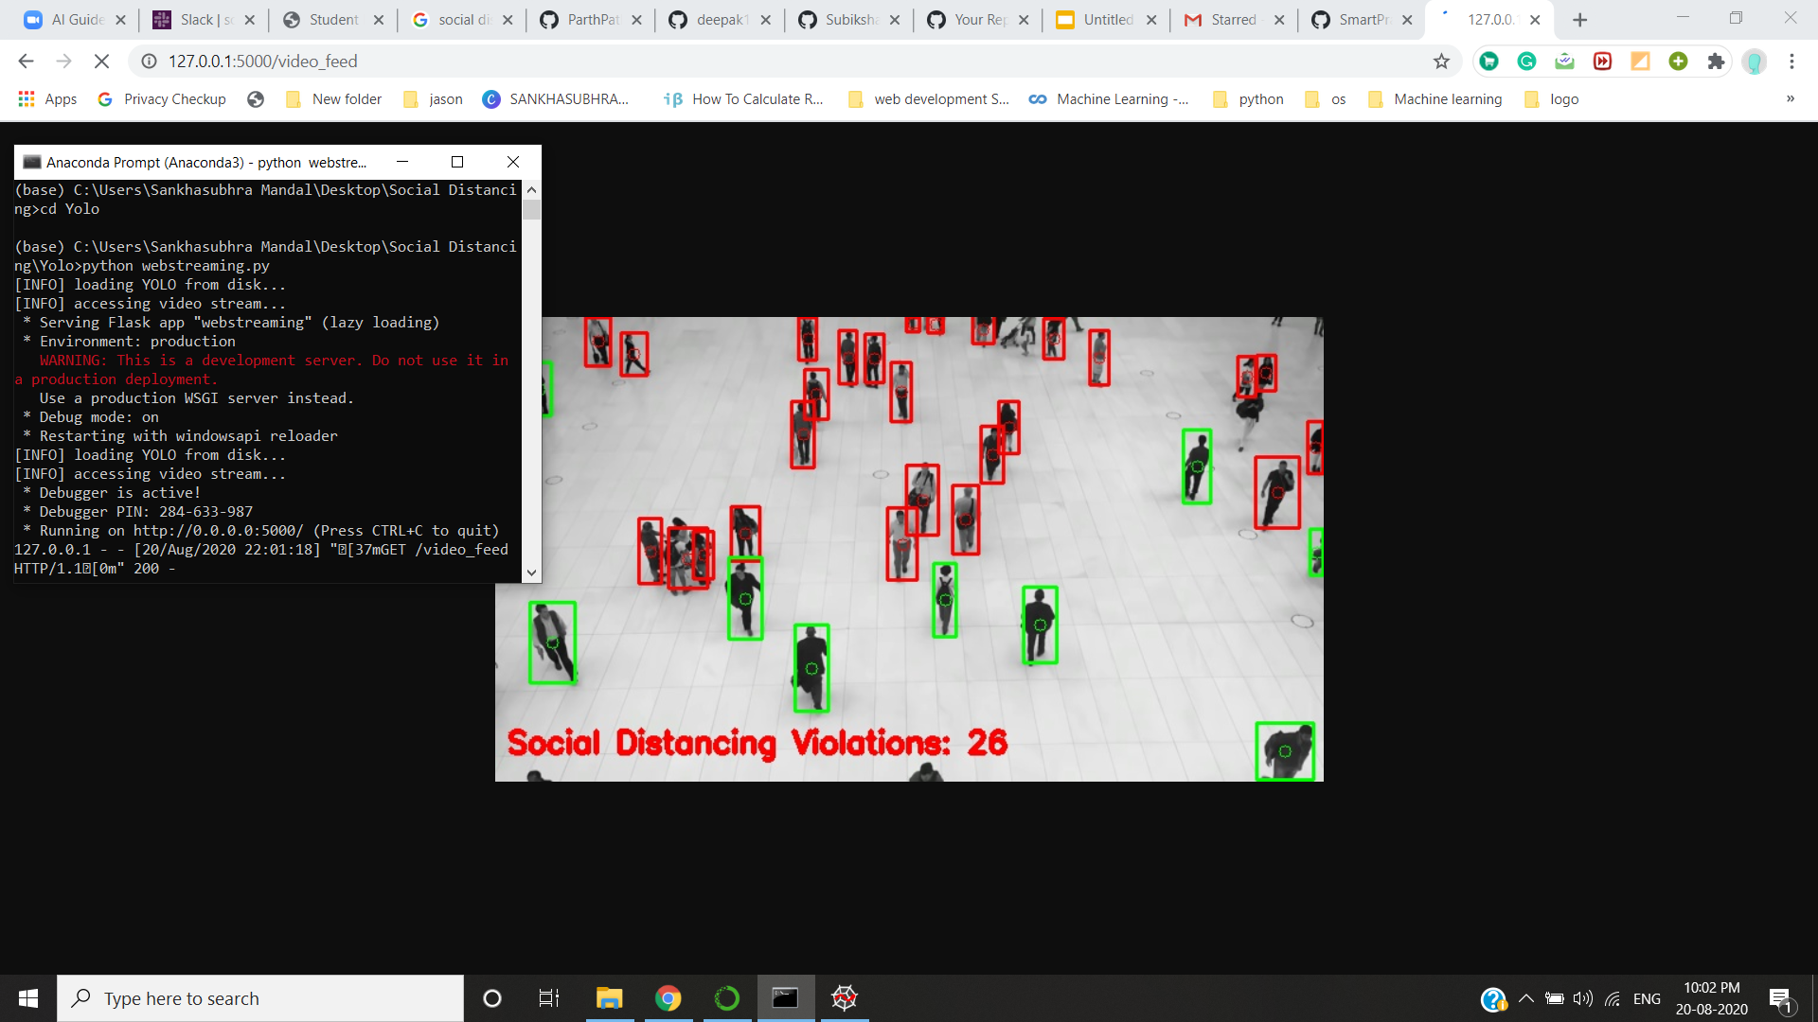

Slide 11
Applications
Airports
Hospitals
Offices
Manufacturing plants
Retail shops
Metro Stations
Public libraries
Schools
Religious Places
Conclusions
This program is a very simple and basic implementation of the Social Distancing Detector. This code can serve as a basis for more complex programs which can be developed from this.

Slide 12
Future Scope
We can extend this by following way:
1.Send Voice Alerts Automatically
Send voice alerts via speakers installed at a specific place when someone violates social distancing. Also, set the rate of detection of faces and sending warnings.
2.Multi-Channel Recognition
Add multiple cameras in a few minutes and allow cameras to access the capability of AI to recognize faces.
3.No new hardware required
You don’t need new cameras to enable the platform. Instead, it can work on the existing RTSP camera and connect to your existing smart speakers.

